Slide 1
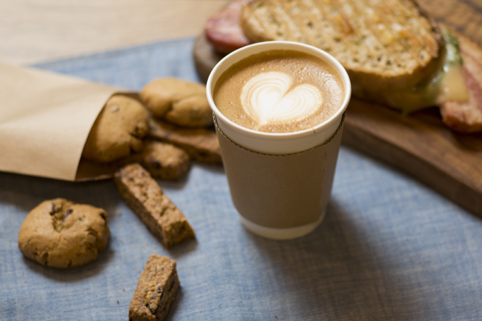
prepare your coffee and snacks
today's lecture materials are quite heavy
Start 08:30

Slide 2
Computer Vision
Part 1: Features and Detectors
ADF – Start 08:30

Slide 3

Agenda
Part 1: Features and Detectors
Harris Corner Detector, Image Pyramid
Part 2: Feature Descriptors
HoG, Blob Detector, and SIFT
Computer Vision

Slide 4
Filtering as Detection
Computer Vision

Slide 5
Applications To Have In Mind
Part of the same photo?
Same computer from another angle?
Computer Vision

Slide 6
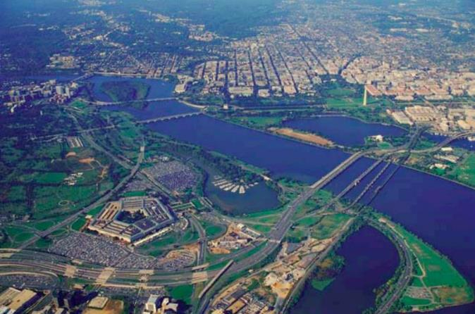
Applications To Have In Mind
Same building from another angle?
Computer Vision

Slide 7
Image patches as filters
Goal: find in an image
Computer Vision

Slide 8
Image patches as filters
Goal: find in an image
Detected location
Input
Filtered Image
Filtered (scaled)
Normalized
x-correlation
Thresholded Image
Computer Vision

Slide 9
Recognizing objects: is it really so hard?
Image patch
Find the chair in this image
Output of normalized correlation
Computer Vision

Slide 10
Recognizing objects: is it really so hard?
Image patch
Find the chair in this image
Output of normalized correlation
Not so Great
Computer Vision

Slide 11
Image Matching
Computer Vision

Slide 12
Applications To Have In Mind
Computer Vision

Slide 13
Applications To Have In Mind
Building a 3D Reconstruction Out Of Images
Computer Vision

Slide 14
Applications To Have In Mind
Stitching photos taken at different angles
Computer Vision

Slide 15
Image Alignment
Given two images: how do you align them programmatically?
Computer Vision

Slide 16
Image Alignment
Given two images: how do you align them programmatically?
Computer Vision

Slide 17
Brute Force Solution
for y in range(ySearch,ySearch+1):
for x in range(xSearch,xSearch+1):
#touches all HxW pixels check_alignment_with_images()
Computer Vision

Slide 18
Image Part Alignment
Given two images: how do you align them?
These aren’t off by a small 2D translation but instead by a 3D rotation + translation of the camera.
Computer Vision

Slide 19
Brute Force Solution
for y in yRange:
for x in xRange:
for z in zRange:
for xRot in xRotVals:
for yRot in yRotVals:
for zRot in zRotVals:
#touches all HxW pixels!
check_alignment_with_images()
This code should make you really unhappy
Note: this actually isn’t even the full number of parameters; it’s actually 8 for loops.
Computer Vision

Slide 20
An Alternate Approach
Given two images: how would you align them?
1. Identify interest points,
Computer Vision

Slide 21
An Alternate Approach
Finding and Matching
1. Identify interest points,
2. Extract feature vector descriptor
3. match based on local image data
Computer Vision

Slide 22
An Alternate Approach
Detection: identify interest points
Description: extract feature vector
Matching: determine correspondence between descriptor
Computer Vision

Slide 23
Matching Problem
Vision tasks such as stereo and motion estimation require finding corresponding features across two or more views.
Computer Vision

Slide 24
Can you find the correspondences?
Computer Vision

Slide 25
Can you find the correspondences?
Computer Vision

Slide 26
Image Feature
Computer Vision

Slide 27
Image Feature
Information extracted from an image/video.
Hand crafted or Automatically learned
Feature Engineering function
Takes an image/video as an input
Produces one or more numbers as output
Computer Vision

Slide 28
Types of Feature
Global features
Extracted from the entire image
Examples: template (the image itself), HOG, etc.
Region based features
Extracted from a smaller window of the image.
Applying global method to a specific image region.
Local features
Describe a pixel, and the vicinity around a specific pixel.
Local feature always refer to a specific pixel location.
Computer Vision

Slide 29
Uses of Feature
Features can be used for many computer vision problems.
Detection, Recognition, Tracking, Stereo estimation.
Different types of features for different problems,
Different assumptions about the images.
That is why there are many different types of features.
Computer Vision

Slide 30
Characteristics of good features
Repeatable
should find same things even with distortion
Saliency
each feature should be distinctive and uniquely identified
Compactness
shouldn’t just be all the pixels
Locality
should only depend on local image data
Computer Vision

Slide 31
Compactness and Efficiency
We want the representation to be as small and as fast as possible
Much smaller than a whole image
We’d like to be able to run the detection procedure independently per image
Match just the compact descriptors for speed.
Computer Vision

Slide 32
Trade-offs
More Repeatable
Robust detection
Precise localization
Detection of Interest Point
More Points
Robust to occlusion
Works with less texture
Description of Patches
More Flexible
Robust to expected variations
Maximize correct matches
More Distinctive
Minimize wrong matches
Computer Vision

Slide 33
Keypoint
Computer Vision

Slide 34

Patch Matching
$$\begin{aligned}? \\ =\end{aligned}$$
Intuition: this would be a good patch for matching, since it is very distinctive
(there is only one patch in the second frame that looks similar).
Computer Vision

Slide 35
Patch Matching
$$\begin{aligned}? \\ =\end{aligned}$$
Intuition: this would be a BAD patch for matching, since it is not very distinctive (there are many similar patches in the second frame)
Computer Vision

Slide 36
Interest (Key) Point
Expressive texture
The point at which the direction of the boundary of object changes abruptly
Intersection point between two or more edge segments
Computer Vision

Slide 37
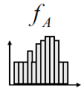
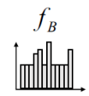
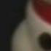
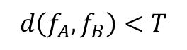
Goals for KeyPoints
Detect set of points that are repeatable and distinctive
Define a region around each key-point
Extract and normalize the region content
Compute a local descriptor from the normalized region
Match local descriptors
x
B₃
A₁
x
x
x
x
x
x
x
A₃
A₂
x
x
x
x
B₂
B₁
$$d\left(f_{A},f_{B}\right)<T$$
Computer Vision

Slide 38
Properties of Interest Points
Detect all (or most) true interest points
No false interest points
Well localized
Robust with respect to noise
Efficient detection
Computer Vision

Slide 39
Corner Detection
Computer Vision

Slide 40
Matching Corner
Junction of contours
Generally more stable features over changes of viewpoint
Large variations in the neighborhood of the point in all direction
They are good features to match
Computer Vision

Slide 41
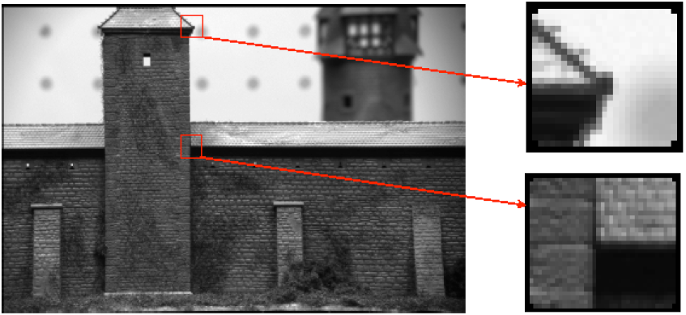
Matching Corner
Computer Vision

Slide 42
Harris Corner Detector
Computer Vision

Slide 43
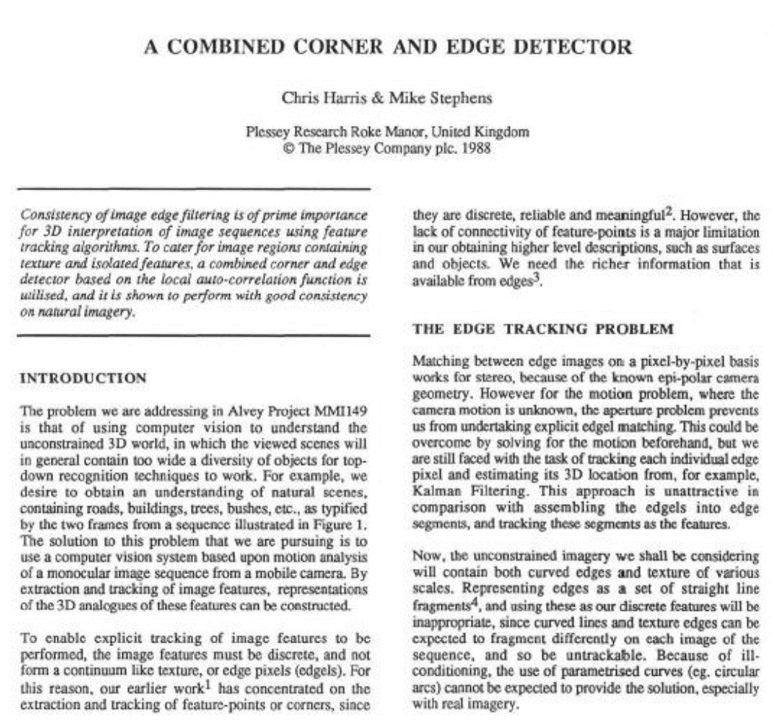
Computer Vision

Slide 44
Basic Idea
Corner point can be recognized in a small window
Shifting a window in any direction should give a large change in intensity
Compute image gradients over a small region (not just a single pixel).
Computer Vision

Slide 45
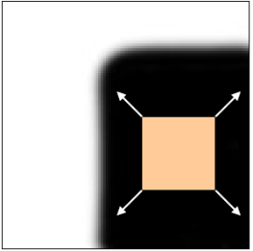
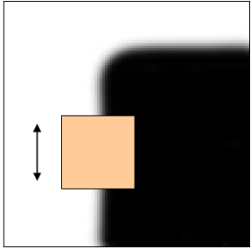
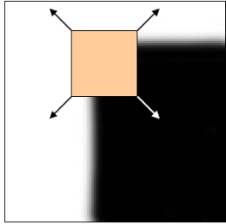
Basic Idea
Shifting the window in any direction should yield a large change in appearance
“flat”region:
no change in all directions
“edge”:
no change along the edge direction
“corner”:
significant change in all directions
Computer Vision

Slide 46
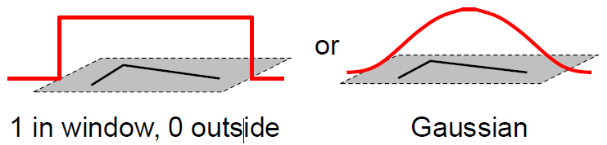
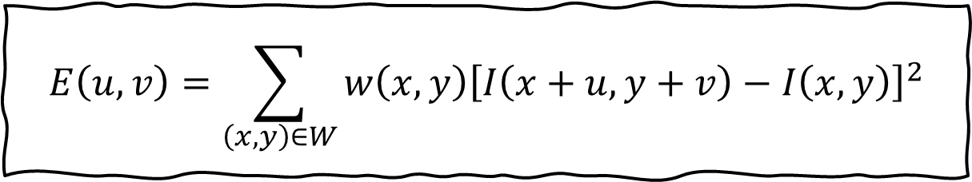
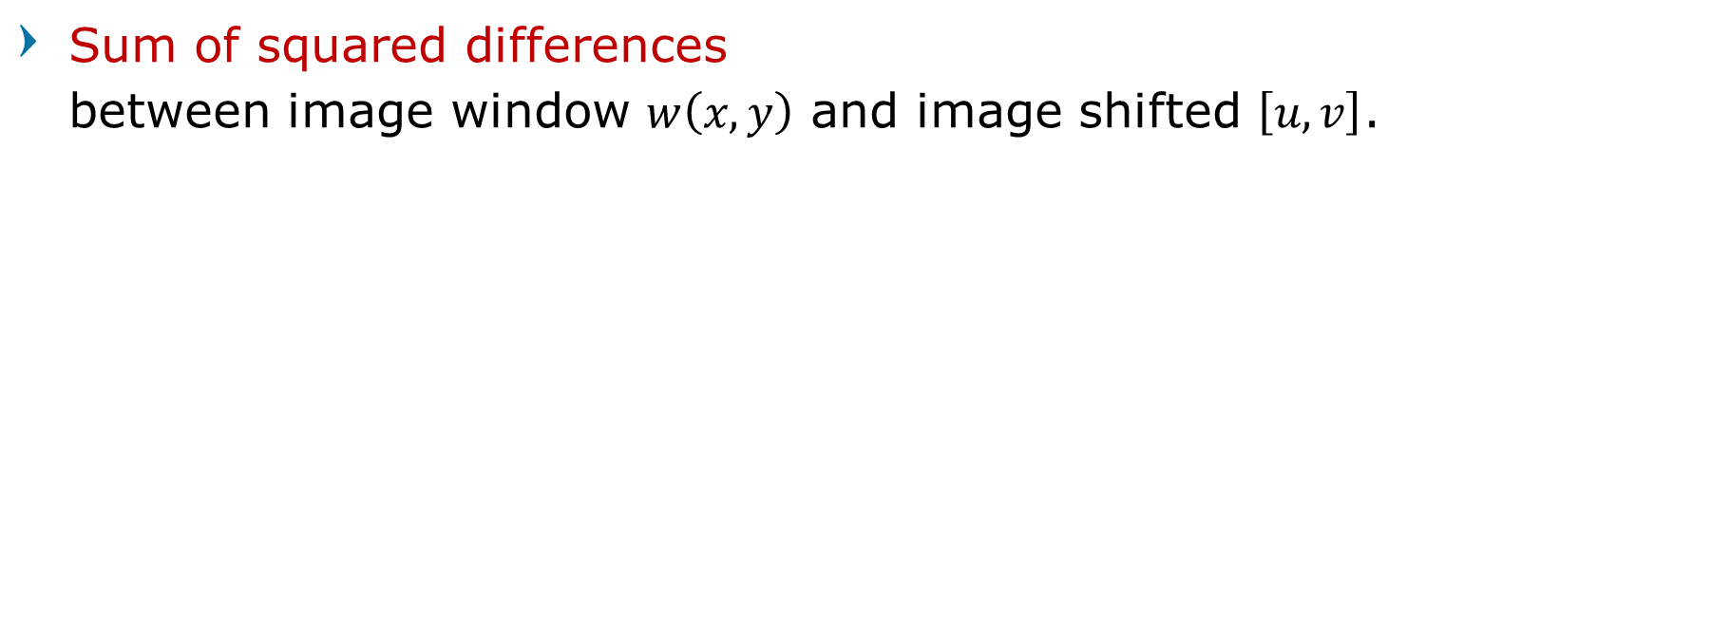
Formalizing Corner Detection
Sum of squared differences between image window $w\left(x,y\right)$ and image shifted $\left[u,v\right]$.
$$E\left(u, v\right)=\sum_{\left(x,y\right)∈W}{w\left(x,y\right){\left[I\left(x+u, y+v\right)−I\left(x,y\right)\right]}^{2}}$$
Error function
Window function
Shifted intensity
Intensity
Computer Vision

Slide 47
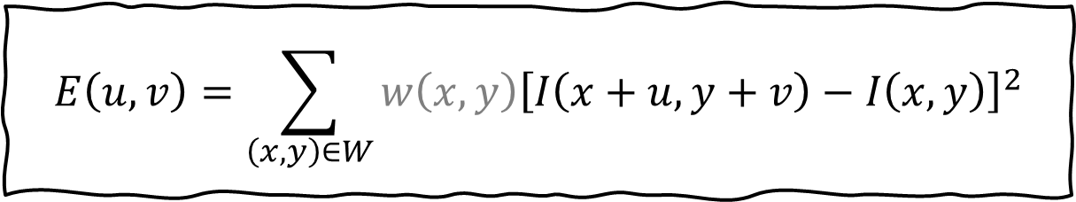
Formalizing Corner Detection
Sum of squared differences between image window $w\left(x,y\right)$ and image shifted $\left[u,v\right]$.
$$E\left(u, v\right)=\sum_{\left(x,y\right)∈W}{w\left(x,y\right){\left[I\left(x+u, y+v\right)−I\left(x,y\right)\right]}^{2}}$$
For nearly constant patches, this will be near 0.
For very distinctive patches, this will be larger.
Hence... we want patches where E(u,v) is LARGE.
Computer Vision

Slide 48

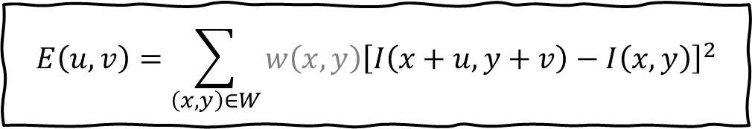
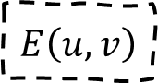

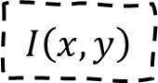

Corner Detection by Auto-correlation
Sum of squared differences between image window $w\left(x,y\right)$ and image shifted $\left[u,v\right]$.
$$E\left(u, v\right)=\sum_{\left(x,y\right)∈W}{w\left(x,y\right){\left[I\left(x+u, y+v\right)−I\left(x,y\right)\right]}^{2}}$$
$$I\left(x,y\right)$$
$$E\left(u,v\right)$$
$$E\left(0,0\right)$$
$$w\left(x,y\right)$$
Computer Vision

Slide 49

Corner Detection by Auto-correlation
Sum of squared differences between image window $w\left(x,y\right)$ and image shifted $\left[u,v\right]$.
$$E\left(u, v\right)=\sum_{\left(x,y\right)∈W}{w\left(x,y\right){\left[I\left(x+u, y+v\right)−I\left(x,y\right)\right]}^{2}}$$
$$I\left(x,y\right)$$
$$E\left(3,2\right)$$
$$E\left(u,v\right)$$
$$w\left(x,y\right)$$
Computer Vision

Slide 50
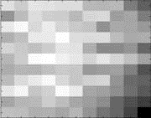
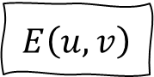
Corner Detection Example Cases
$$E\left(u, v\right)$$
Computer Vision

Slide 51

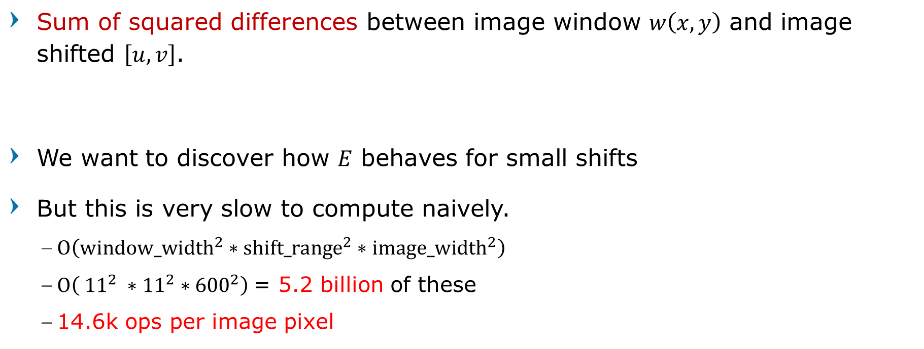
Formalizing Corner Detection
Sum of squared differences between image window $w\left(x,y\right)$ and image shifted $\left[u,v\right]$.
We want to discover how $E$ behaves for small shifts
But this is very slow to compute naively.
$Ο\left({\text{window}\text{_}\text{width}}^{2}∗{\text{shift}\text{_}\text{range}}^{2}∗{\text{image}\text{_}\text{width}}^{2}\right)$
$Ο\left( {11}^{2} ∗{11}^{2}∗{600}^{2}\right)$= 5.2 billion of these
14.6k ops per image pixel
$$E\left(u, v\right)=\sum_{\left(x,y\right)∈W}{w\left(x,y\right){\left[I\left(x+u, y+v\right)−I\left(x,y\right)\right]}^{2}}$$
Computer Vision

Slide 52
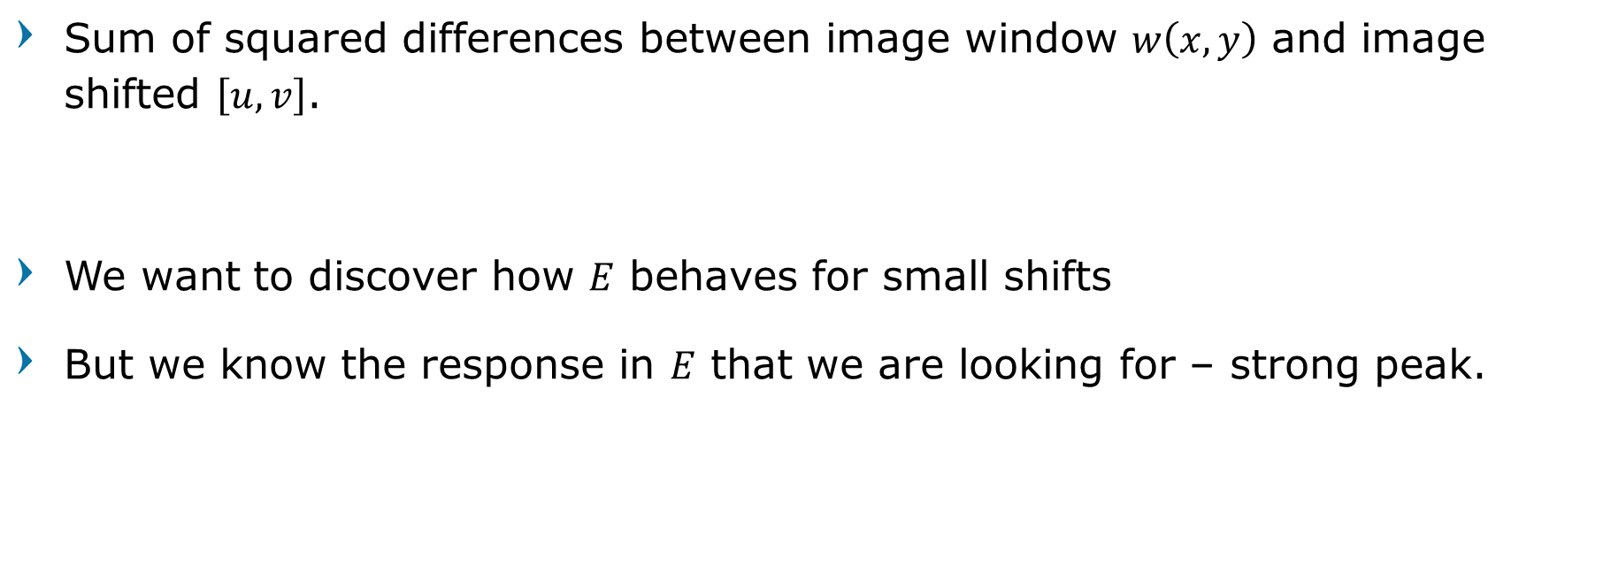
Formalizing Corner Detection
Sum of squared differences between image window $w\left(x,y\right)$ and image shifted $\left[u,v\right]$.
We want to discover how $E$ behaves for small shifts
But we know the response in $E$ that we are looking for – strong peak.
$$E\left(u, v\right)=\sum_{\left(x,y\right)∈W}{w\left(x,y\right){\left[I\left(x+u, y+v\right)−I\left(x,y\right)\right]}^{2}}$$
Computer Vision

Slide 53
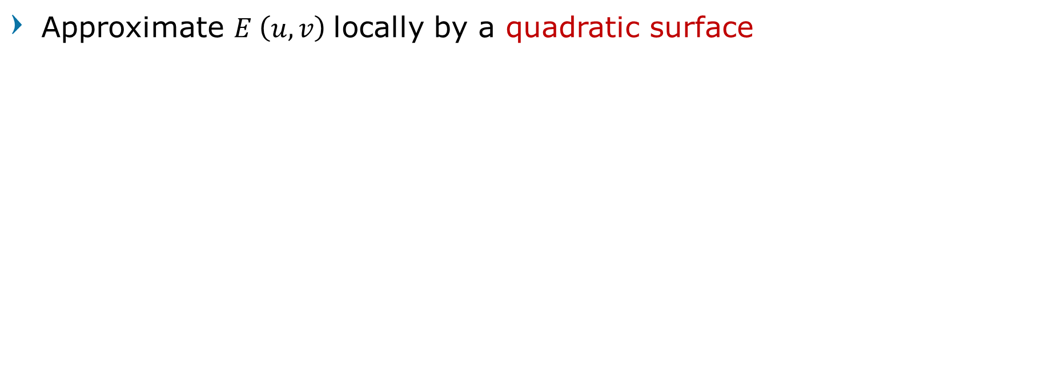

Corner Detection: strategy
Approximate $E \left(u, v\right)$locally by a quadratic surface
$$≈$$
Computer Vision

Slide 54
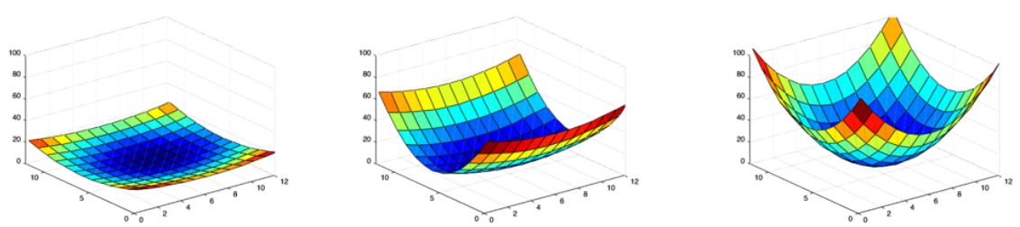
Corner Detection: strategy
flat
edge
'line'
corner
'dot'
Computer Vision

Slide 55
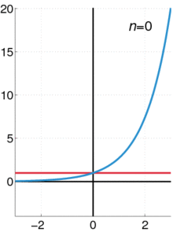
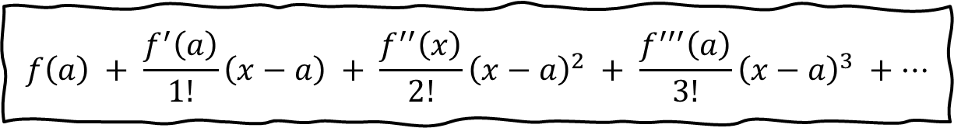
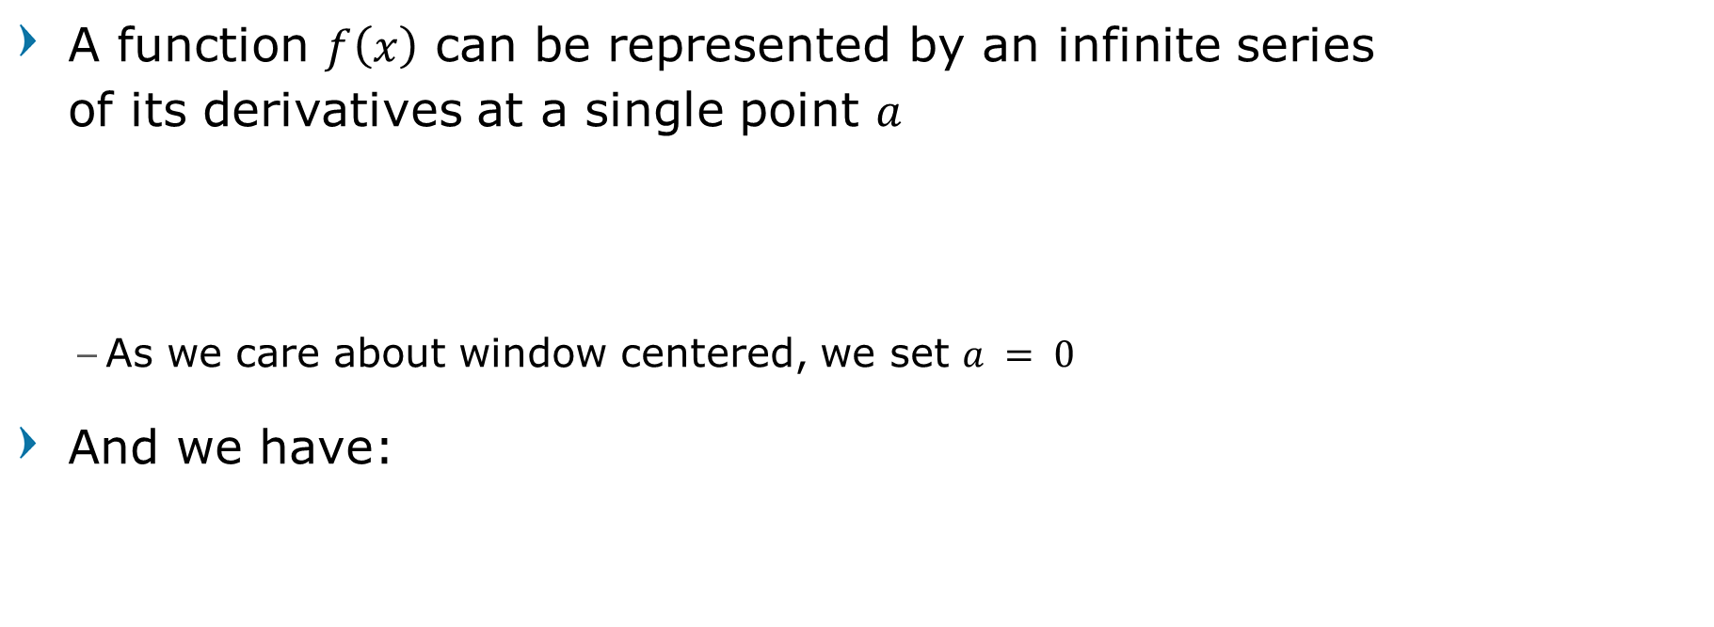
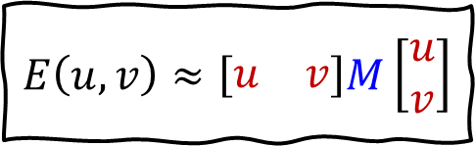
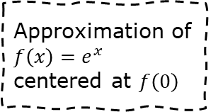
Recall: Taylor series expansion
A function $f\left(x\right)$ can be represented by an infinite series of its derivatives at a single point $a$
As we care about window centered, we set $a = 0$
And we have:
$$f\left(a\right) + \frac{f^{′}\left(a\right)}{1!}\left(x−a\right) + \frac{f^{′′}\left(x\right)}{2!}{\left(x−a\right)}^{2} + \frac{f^{′′′}\left(a\right)}{3!}{\left(x−a\right)}^{3} +…$$
$$E\left(u, v\right)≈\left[\begin{matrix}u & v\end{matrix}\right]M\left[\begin{aligned}u \\ v\end{aligned}\right]$$
Approximation of $f\left(x\right)=e^{x}$
centered at $f\left(0\right)$
Computer Vision

Slide 56
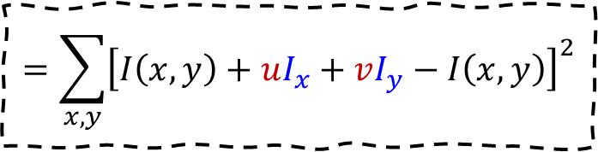
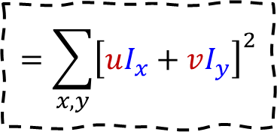
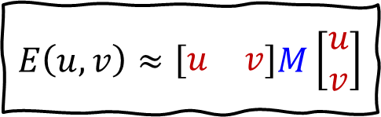
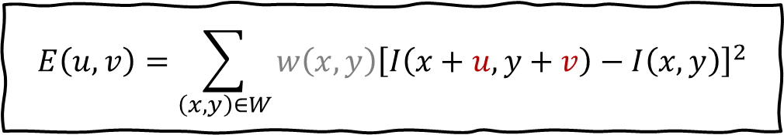
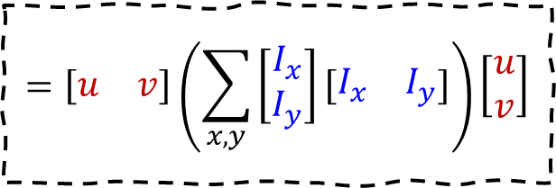
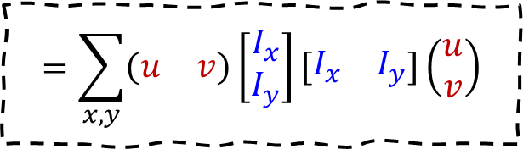
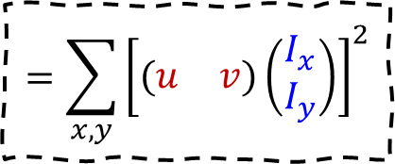
Corner Detection by Auto-correlation
$$E\left(u, v\right)=\sum_{\left(x,y\right)∈W}{w\left(x,y\right){\left[I\left(x+u, y+v\right)−I\left(x,y\right)\right]}^{2}}$$
Taylor Series
$$=\sum_{x,y}{{\left[I\left(x,y\right)+uI_{x}+vI_{y}−I\left(x,y\right)\right]}^{2}}$$
$$=\sum_{x,y}{{\left[uI_{x}+vI_{y}\right]}^{2}}$$
$$=\sum_{x,y}{{\left[\left(\begin{matrix}u & v\end{matrix}\right)\left(\begin{aligned}I_{x} \\ I_{y}\end{aligned}\right)\right]}^{2}}$$
$$=\sum_{x,y}{\left(\begin{matrix}u & v\end{matrix}\right)\left[\begin{aligned}I_{x} \\ I_{y}\end{aligned}\right]\left[\begin{matrix}I_{x} & I_{y}\end{matrix}\right]\left(\begin{aligned}u \\ v\end{aligned}\right)}$$
$$=\left[\begin{matrix}u & v\end{matrix}\right]\left(\sum_{x,y}{\left[\begin{aligned}I_{x} \\ I_{y}\end{aligned}\right]\left[\begin{matrix}I_{x} & I_{y}\end{matrix}\right]}\right)\left[\begin{aligned}u \\ v\end{aligned}\right]$$
$$E\left(u, v\right)≈\left[\begin{matrix}u & v\end{matrix}\right]M\left[\begin{aligned}u \\ v\end{aligned}\right]$$
Computer Vision

Slide 57
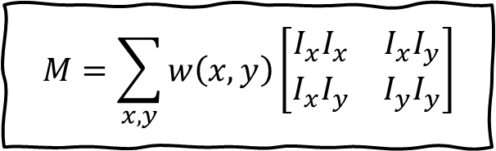
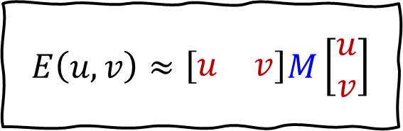
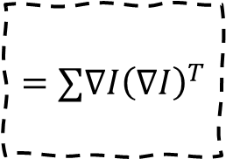
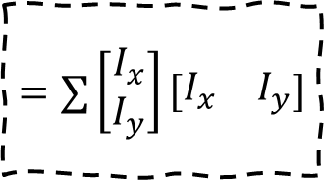
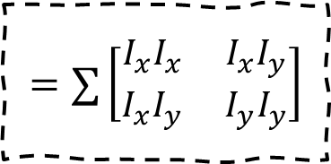
Corner Detection by Auto-correlation
The quadratic approximation simplifies to
where M is a second moment matrix computed from image derivatives
$$E\left(u, v\right)≈\left[\begin{matrix}u & v\end{matrix}\right]M\left[\begin{aligned}u \\ v\end{aligned}\right]$$
Ellipse notation
$$M=\sum_{x,y}{w\left(x,y\right)\left[\begin{matrix}I_{x}I_{x} & I_{x}I_{y} \\ I_{x}I_{y} & I_{y}I_{y}\end{matrix}\right]}$$
$$=∑\left[\begin{matrix}I_{x}I_{x} & I_{x}I_{y} \\ I_{x}I_{y} & I_{y}I_{y}\end{matrix}\right]$$
$$=∑\left[\begin{aligned}I_{x} \\ I_{y}\end{aligned}\right]\left[\begin{matrix}I_{x} & I_{y}\end{matrix}\right]$$
$$=∑∇I{\left(∇I\right)}^{T}$$
Computer Vision

Slide 58
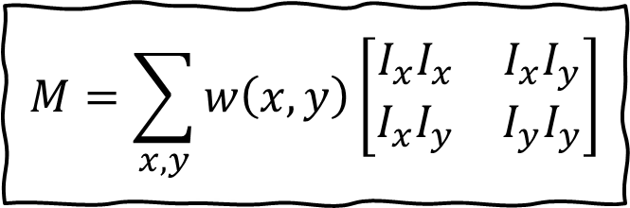
2D Derivatives
$$M=\sum_{x,y}{w\left(x,y\right)\left[\begin{matrix}I_{x}I_{x} & I_{x}I_{y} \\ I_{x}I_{y} & I_{y}I_{y}\end{matrix}\right]}$$
Computer Vision

Slide 59
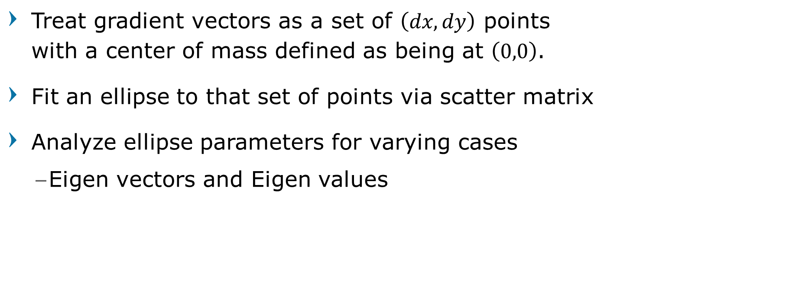
Harris Corner - Intuitively
Treat gradient vectors as a set of $\left(dx,dy\right)$ points with a center of mass defined as being at $\left(0,0\right)$.
Fit an ellipse to that set of points via scatter matrix
Analyze ellipse parameters for varying cases
Eigen vectors and Eigen values
Computer Vision

Slide 60
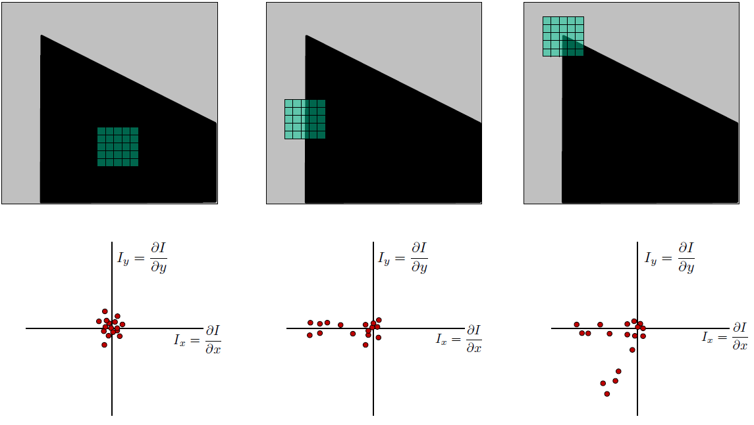
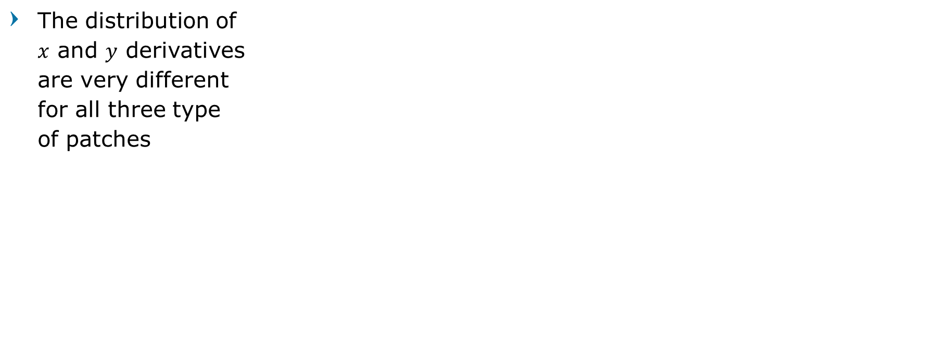
2D Derivatives Distribution
The distribution of $x$ and $y$ derivatives are very different for all three type of patches
Computer Vision

Slide 61
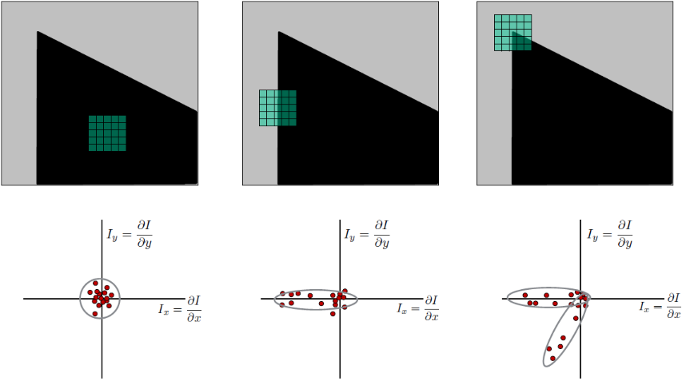
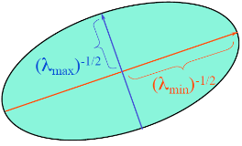
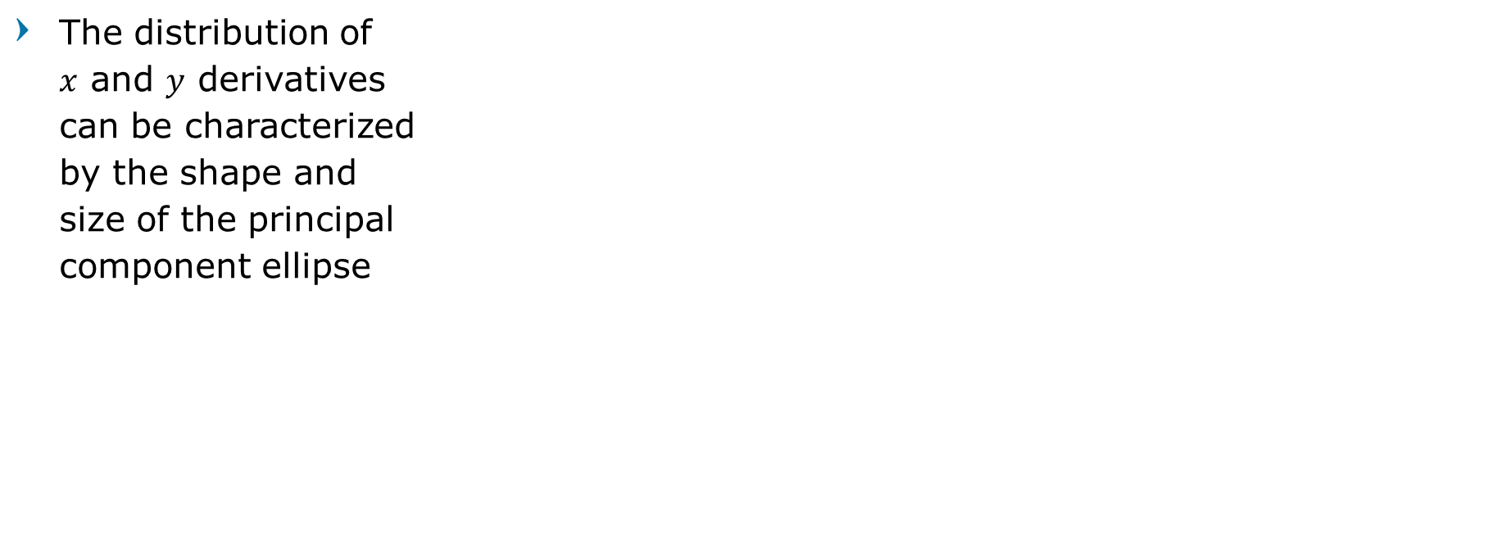
2D Derivatives Distribution
The distribution of $x$ and $y$ derivatives can be characterized by the shape and size of the principal component ellipse
Computer Vision

Slide 62
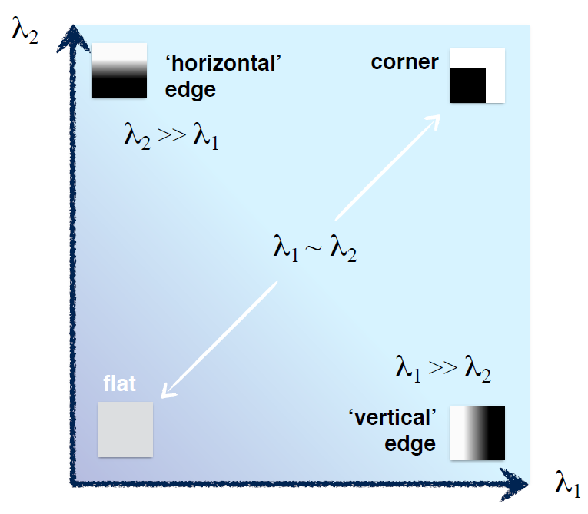
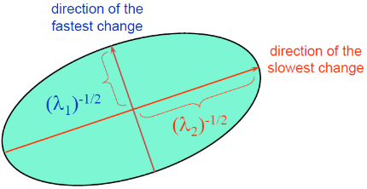
Interpreting Eigenvalues of M
Computer Vision

Slide 63

Interpreting Eigenvalues of M
Computer Vision

Slide 64



Eigenvalues of M
If $λ_{1}$ and $λ_{2}$ are both small : flat
If one is big, one is small : edge
If $λ_{1}$ and $λ_{2}$ both big : corner
$$M=R^{−1}\left[\begin{matrix}λ_{1} & 0 \\ 0 & λ_{2}\end{matrix}\right]R$$
Computer Vision

Slide 65




Corners as distinctive interest points
2 x 2 matrix of image derivatives (averaged in neighborhood of a point)
$$M=\sum_{\left(x,y\right)}{w\left(x,y\right)\left[\begin{matrix}I_{x}I_{x} & I_{x}I_{y} \\ I_{x}I_{y} & I_{y}I_{y}\end{matrix}\right]}$$
$$I_{x}⇔\frac{∂I}{∂x}$$
$$I_{y}⇔\frac{∂I}{∂y}$$
$$I_{x}I_{y}⇔\frac{∂I}{∂x}\frac{∂I}{∂y}$$
Computer Vision

Slide 66

Harris Corner Detection
Compute $M$ matrix for each window to recover a corner-ness score $R$
We can find $M$ purely from the per pixel image derivatives!
Threshold to find pixels which give large corner response
Find the local maxima pixels,
i.e., non maximal suppression.
Computer Vision

Slide 67
Harris Corner Detector Step-by-Step
Computer Vision

Slide 68




0. Input image, We want to compute $M$ at each pixel.
1. Compute image derivatives (optionally, blur first)
2. Compute 𝑀 components as squares of derivatives
3. Convolve with larger window of Gaussian filter $g()$
4. Compute scalar corner-ness
5. Threshold on $R$ to pick high corner-ness
6. Non-maximal suppression to pick peaks
$$I$$
$$I_{x}$$
$$I_{y}$$
Computer Vision

Slide 69







0. Input image, We want to compute $M$ at each pixel.
1. Compute image derivatives (optionally, blur first)
2. Compute 𝑀 components as squares of derivatives
3. Convolve with larger window of Gaussian filter $g()$
4. Compute scalar corner-ness
5. Threshold on $R$ to pick high corner-ness
6. Non-maximal suppression to pick peaks
$$I$$
$$I_{x}$$
$$I_{y}$$
$$I_{x}^{2}$$
$$I_{y}^{2}$$
$$I_{x}I_{y}$$
Computer Vision

Slide 70








0. Input image, We want to compute $M$ at each pixel.
1. Compute image derivatives (optionally, blur first)
2. Compute 𝑀 components as squares of derivatives
3. Convolve with larger window of Gaussian filter $g()$
4. Compute scalar corner-ness
5. Threshold on $R$ to pick high corner-ness
6. Non-maximal suppression to pick peaks
$$I$$
$$I_{x}$$
$$I_{y}$$
$$=g\left(I_{x}^{2}\right),g\left(I_{y}^{2}\right),g\left(I_{x}∘I_{y}\right)$$
$$I_{x}^{2}$$
$$I_{y}^{2}$$
$$I_{x}I_{y}$$
$$g\left(I_{x}^{2}\right)$$
$$g\left(I_{y}^{2}\right)$$
$$g\left(I_{x}∘I_{y}\right)$$
Computer Vision

Slide 71













0. Input image, We want to compute $M$ at each pixel.
1. Compute image derivatives (optionally, blur first)
2. Compute 𝑀 components as squares of derivatives
3. Convolve with larger window of Gaussian filter $g()$
4. Compute scalar corner-ness
5. Threshold on $R$ to pick high corner-ness
6. Non-maximal suppression to pick peaks
$$I$$
$$I_{x}$$
$$I_{y}$$
$$I_{x}^{2}$$
$$I_{y}^{2}$$
$$I_{x}I_{y}$$
$$=g\left(I_{x}^{2}\right),g\left(I_{y}^{2}\right),g\left(I_{x}∘I_{y}\right)$$
$$g\left(I_{x}^{2}\right)$$
$$g\left(I_{y}^{2}\right)$$
$$g\left(I_{x}∘I_{y}\right)$$
$$R=\det\left(M\right)−α \text{trace}{\left(M\right)}^{2}$$
$$R=g\left(I_{x}^{2}\right)∘g\left(I_{y}^{2}\right)−g\left(I_{x}∘I_{y}\right)−α{\left[g\left(I_{x}^{2}\right)+g\left(I_{y}^{2}\right)\right]}^{2}$$
$$R$$
Computer Vision

Slide 72
Harris Detector Steps
Computer Vision

Slide 73


Harris Detector Steps
Compute corner response $R$
Computer Vision

Slide 74


Harris Detector Steps
Find points with large corner response
$R$ > threshold
Computer Vision

Slide 75


Harris Detector Steps
Take only the points of local maxima of $R$
Computer Vision

Slide 76

Harris Detector Steps
Computer Vision

Slide 77
Variation of Harris Detectors
Triggs
Szeliski (Harmonic Mean)
Shi-Tomasi
Computer Vision

Slide 78
Problems of Harris Detector
Computer Vision

Slide 79
Desirable Properties
If our detectors are repeatable, they should be:
Invariant to some things: image is transformed and corners remain the same
Covariant/equivariant with some things: image is transformed and corners transform with it.
Computer Vision

Slide 80
Recall Motivating Problem
Images may be different in lighting and geometry (Affine Transformation)
Computer Vision

Slide 81
Properties of Harris Detectors
Invariant with translation [Good]
All done with convolution.
Convolution is translation invariant.
Invariant with rotation [Good]
Rotations just cause the corner rotation to change.
Eigenvalues remain the same.
Computer Vision

Slide 82
Properties of Harris Detectors
Not Invariant with Scaling [BAD]
One pixel can become many pixels and vice-versa.
edge
corner
edge
edge
Computer Vision

Slide 83
Image Pyramid
Computer Vision

Slide 84

Key Idea: Scale
Left to right: each image is half-sized, Unsampled with big pixels below
Computer Vision

Slide 85

Key Idea: Scale
If we apply a $K×K$ filter, how much of the original image does it see in each image?
Computer Vision

Slide 86

Solution to Scales: Try them all
Harris Detection
Harris Detection
Harris Detection
Harris Detection
Computer Vision

Slide 87
Common Trick
Given a 50x16 person detector, how do we detect people at:
(a) 25x8
(b) 100x32
(c) 150x48
(d) 250x80
Computer Vision

Slide 88
Common Trick
Detecting all the people The red box is a fixed size
(a) 25x8
(b) 100x32
(c) 150x48
(d) 250x80
Computer Vision

Slide 89
Common Trick
Detecting all the people The red box is a fixed size
(a) 25x8
(b) 100x32
(c) 150x48
(d) 250x80
Computer Vision

Slide 90
Common Trick
Detecting all the people The red box is a fixed size
(a) 25x8
(b) 100x32
(c) 150x48
(d) 250x80
Computer Vision

Slide 91




Subsample and Aliasing
Take every 8th pixel
Take every 2nd pixel
Take every 16th pixel
Take every 4th pixel
Computer Vision

Slide 92

Subsample and Aliasing
Computer Vision

Slide 93

Gaussian Pyramid
Blur input image with a Gaussian (or binomial) filter
Downsample (throw away every other pixel)
Computer Vision

Slide 94

Gaussian Pyramid
Computer Vision

Slide 95

Break, Question?
Computer Vision

